Slide 1
Benutzerschnittstellen

Slide 2
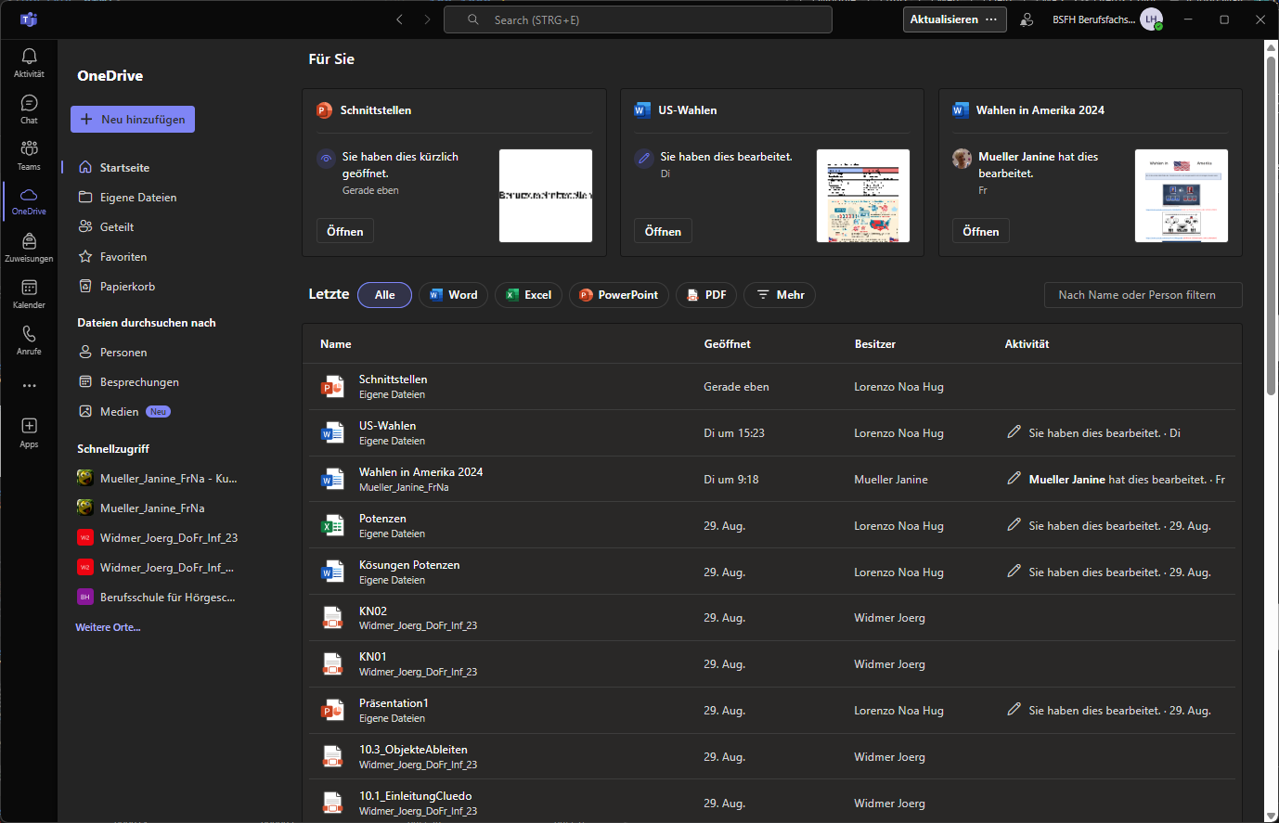
1. GUI (Graphical User Interface)

Slide 3
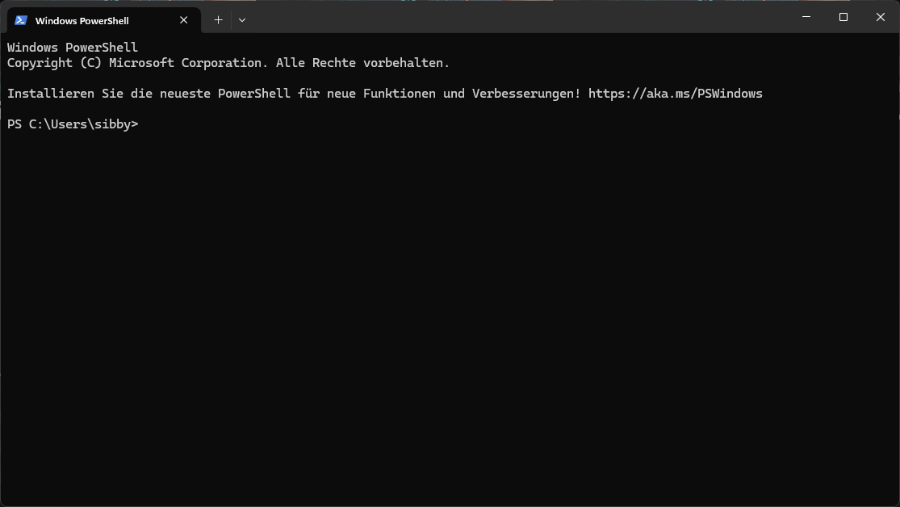
2. CLI (Command Line Interface)

Slide 4
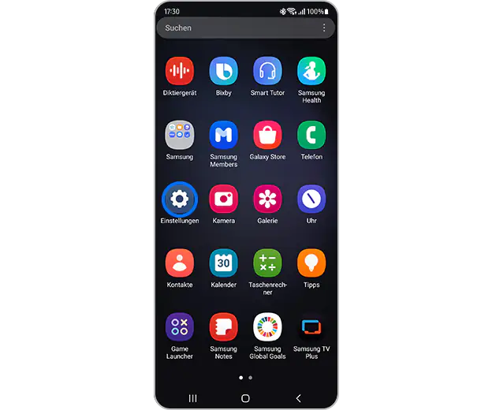
3. TUI (Touch User Interface)

Slide 5
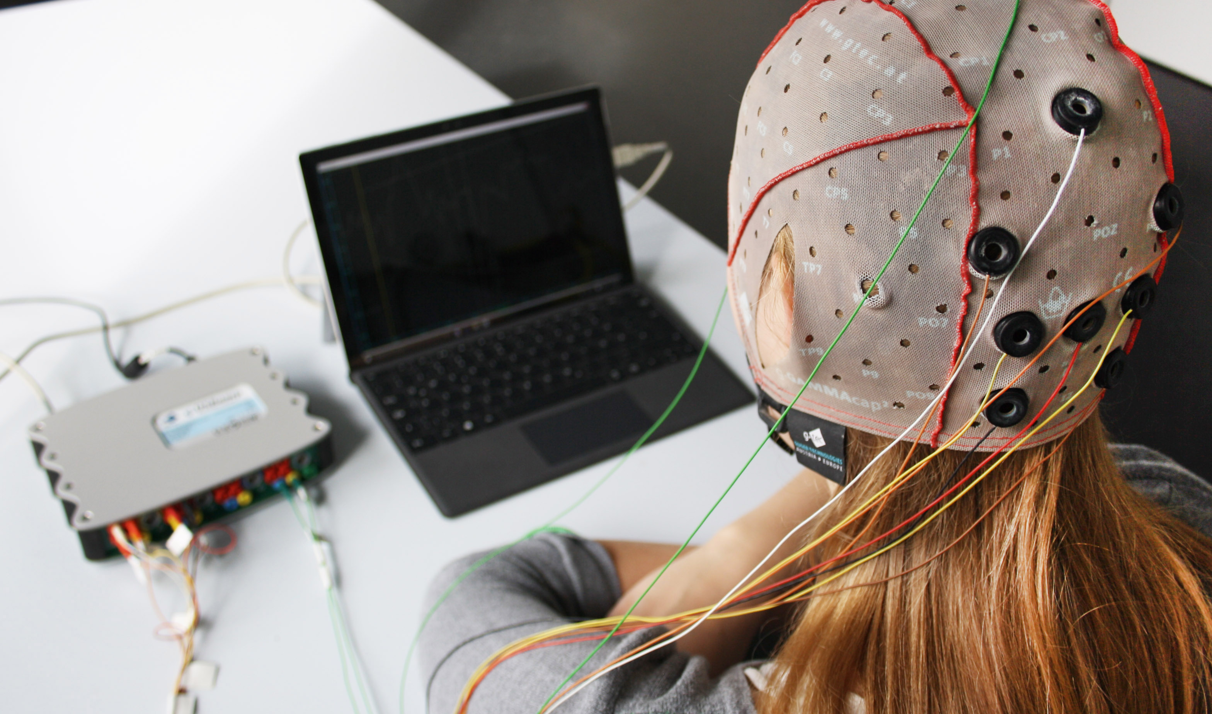
4. BCI (Brain Computer Interface)

Slide 6

5. VUI (Voice User Interface)

